Slide 1

NAB DATATHON
Team: GPT

Slide 2
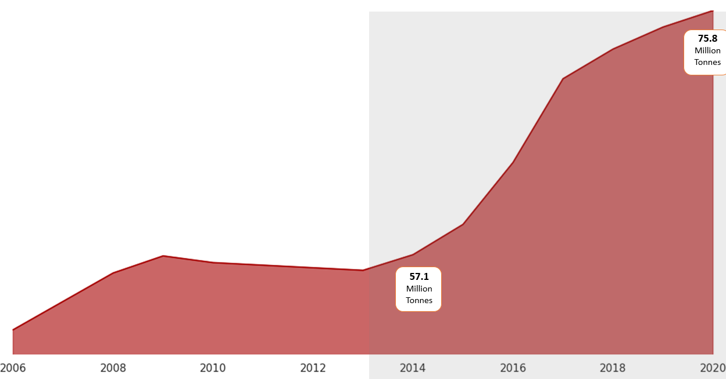
Overall Increasing Trend in Total National Waste
There was a significant increase of 32.75% over the 7-year period from 2014 to 2021.
Australia has seen a rapid increase in the overall amount of waste produced in the recent years
Notes:
Problem with the data, missing mining data that would have skewed the data from 2018 onwards.
There are missing data in 2007-08, 2011-12 and 2012-13.

Slide 3
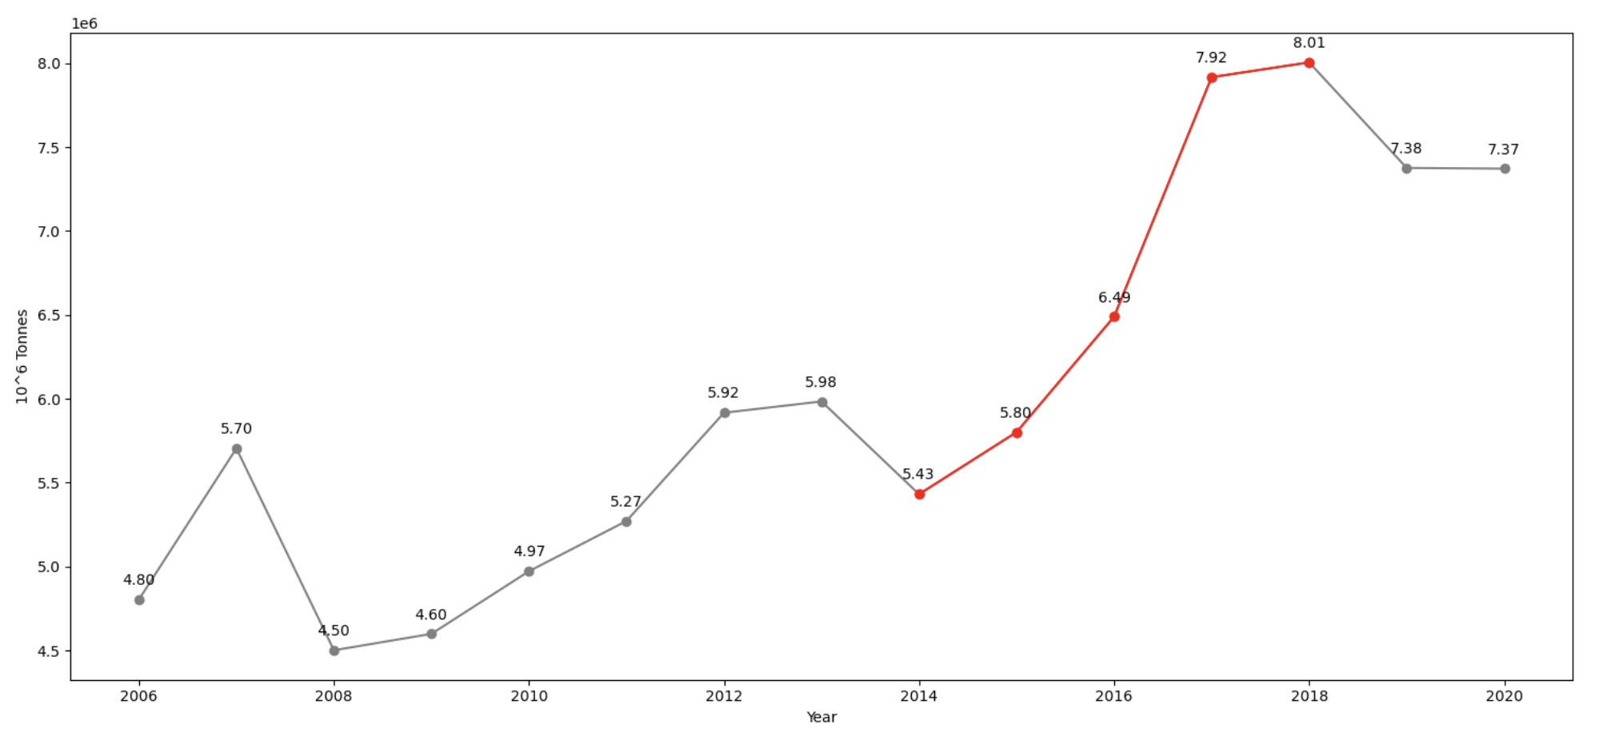
Hazardous waste increased by 53.35% over the 15-year period from 2006 to 2021.
Overall trend in Hazardous Waste
Notably, there was a significant increase of 47.38% over the 4-year period from 2014 to 2018.

Slide 4
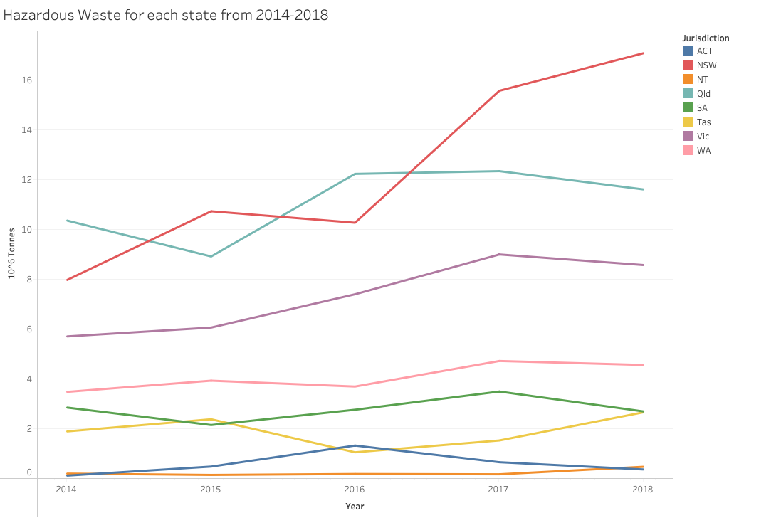
NSW displays the similar increasing trend for the 4-year period from 2014-2018
Hazardous waste increased 114% over the 2014-2018 period for NSW.
In 2018, NSW is responsible for 35.57% of the total Hazardous waste.
Notes:
Highlight NSW
Change Year to date
Explain in percentage terms
Hazardous waste increased 114% over the 2014-2018 period for NSW.
In 2018, NSW is responsible for 35.57% of the total Hazardous waste.

Slide 5
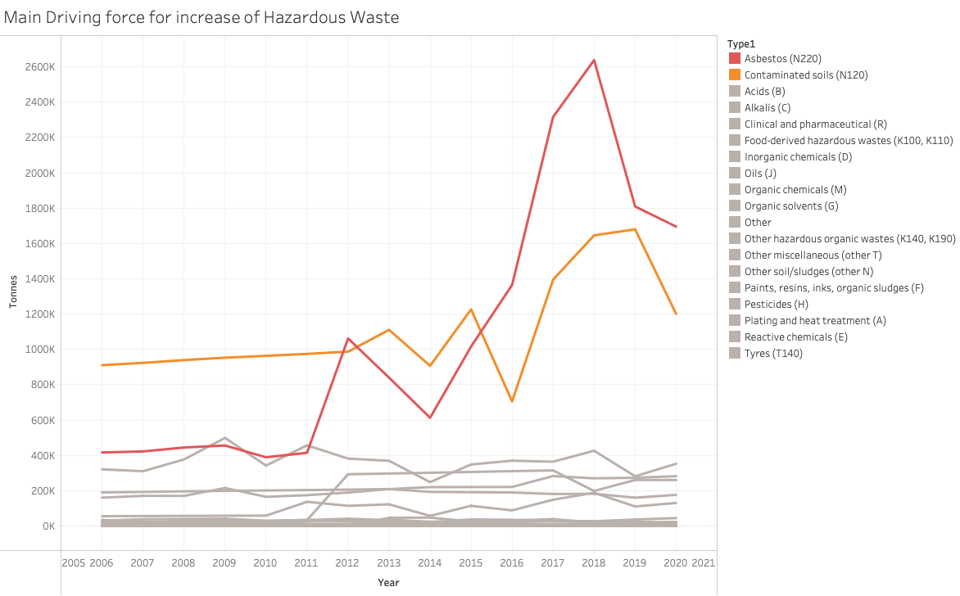
Asbestos (N220) and Contaminated soils (N120) are the main driving for the increasing trend in Hazardous Waste.
N220 increased 330.32%, N120 increased 81.39% over the 2014-2018 period
Notes:
Asbestos has been used for insulation, roofing, flooring, and as a component in various building materials. It has been used in the 1980s in Australia, the suspected reason is that ……, but we cannot say based on the data.
Contaminated soil refers to soil that has been polluted or contaminated by the presence of hazardous substances.

Slide 6
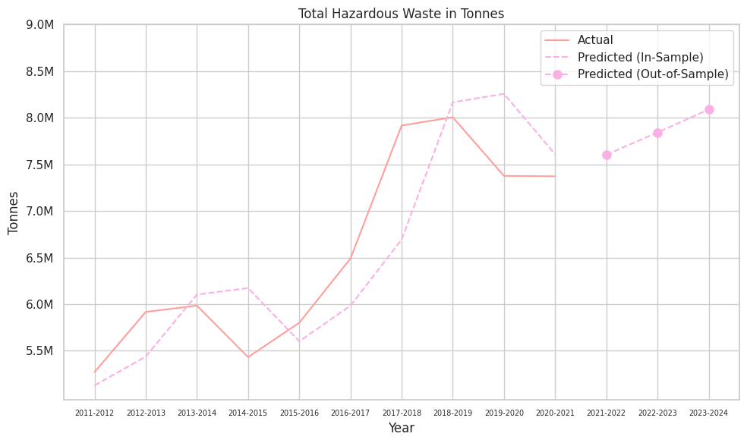
Predictive Model
PREDICTION:
The prediction accuracy is 93.4%.
For next three years: 2021-2022, 2022-2023, and 2023-2024 the prediction of total hazardous waste in Australia are 7.621.421, 7.879.479 and 8.146.274 respectively

Slide 7
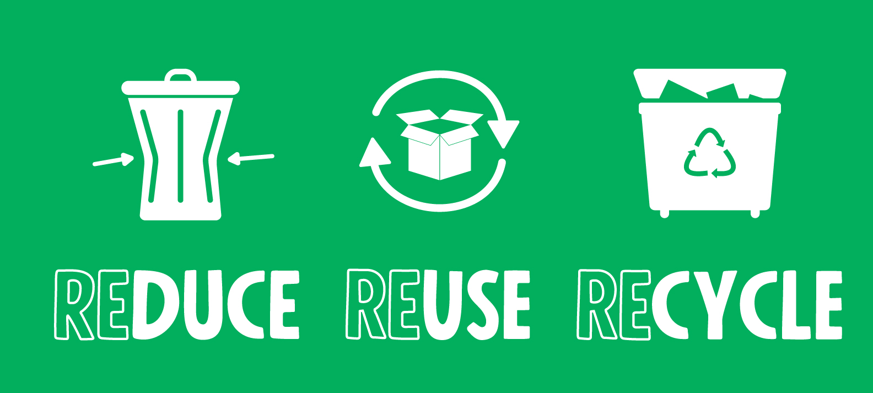
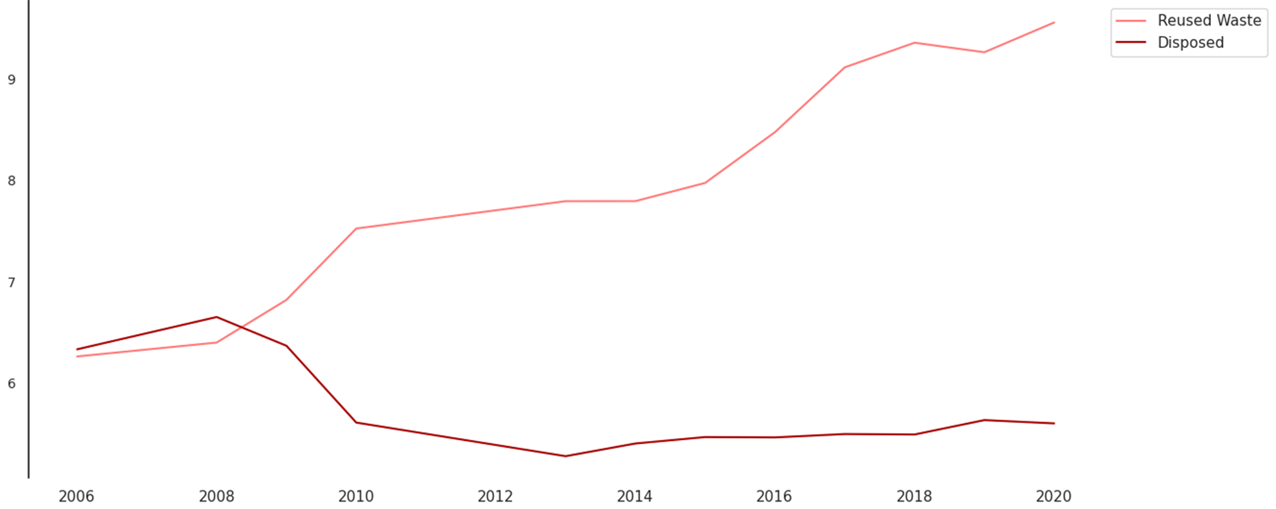
Reuse of Waste
We identified the following “fate” of the waste as a
form of reusage: Energy Recovery, Recycling, Waste Reuse
Vs
Disposal, long-term storage.

Slide 8
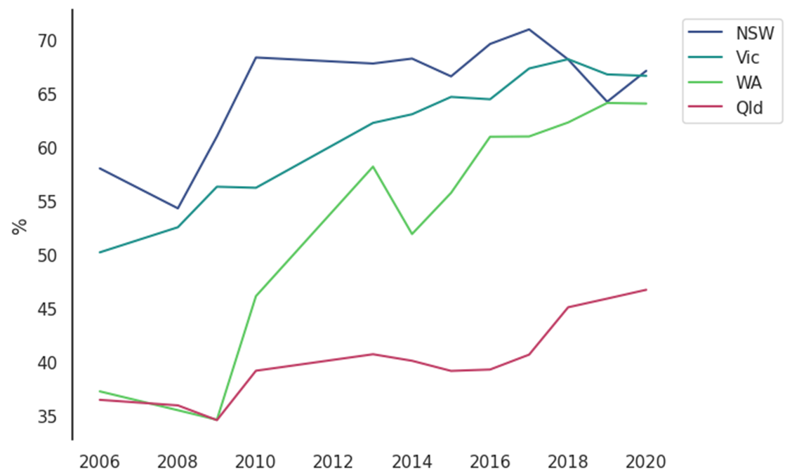
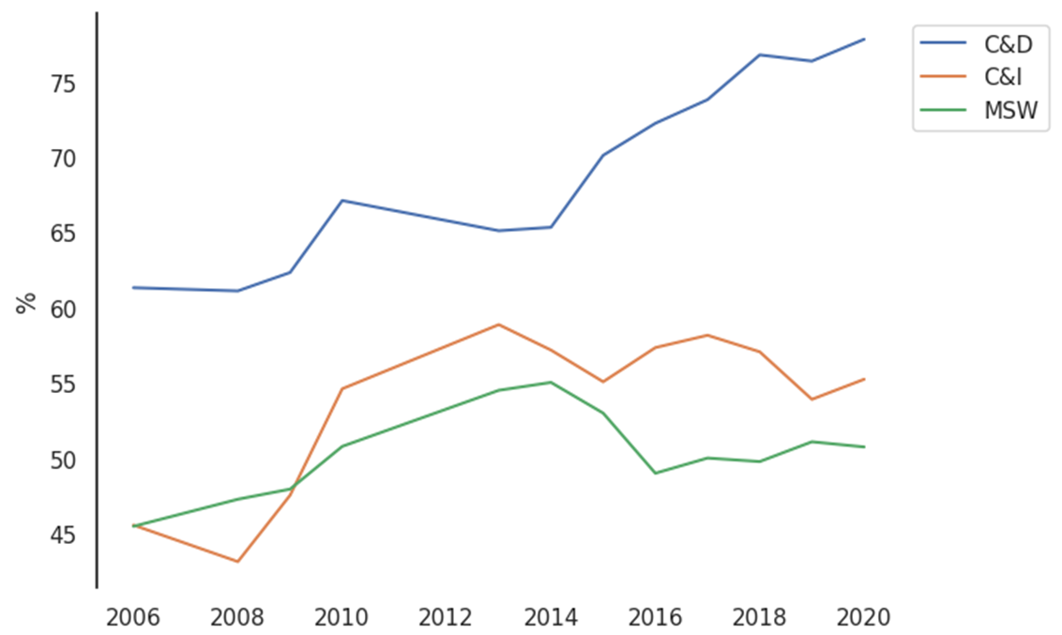
Reuse of Waste Key Observations
% of Reuse of Waste by the
Top 4 Waste Contributing States
Construction and Demolitions have significantly higher rates of waste re-usage
% of Reuse of Waste by Stream
QLD significantly lags behind the other states in terms of Waste Re-usage in any form
NSW, VIC, WA demonstrated significant improvement
QLD’s waste reuse rate
remained substantially below the peer states
Construction and Demolitions have significantly higher rates of recycling

Slide 9
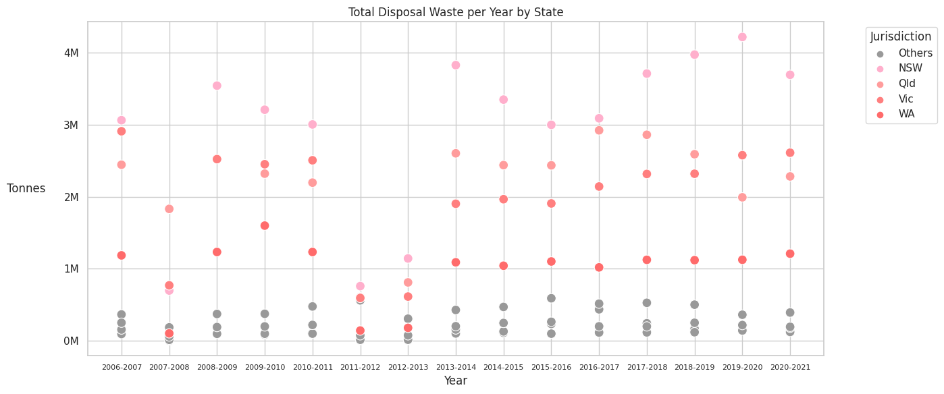
Hypothesis Testing
Null Hypothesis (H0):
There is no significant difference in total waste disposal among
different jurisdictions.
The Anova and Tukey's tests show that NSW, Qld, Vic, and WA have notably higher waste levels.
These areas must prioritize waste reduction strategies.
Results:

Slide 10
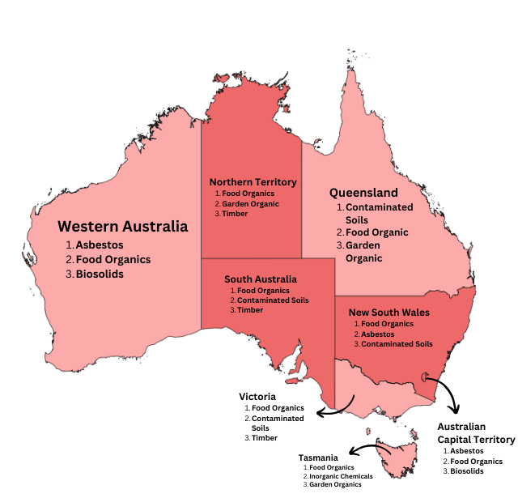
Disposal Waste
Suggested Solutions
1
Asbestose (N220):
Replaced with Cellulose Fiber
2
Contaminated Soils (N120):
Strengthen Policy for Building Demolition
3
Biosoils:
Restoring abandoned mining site
4
Timber:
Recycle for furniture or wood handcraft
Notes:
Citations:
Airsafe. (2015, April 21). Asbestos substitute materials building a safer future. https://www.airsafe.net.au/news/asbestos-substitute-materials-building-a-safer-future/
Collivignarelli, M. C., Canato, M., Abbà, A., & Carnevale Miino, M. (2019). Biosolids: What are the different types of reuse? Journal of Cleaner Production, 238, 117844. https://doi.org/10.1016/j.jclepro.2019.117844
Department of the Environment and Energy. (n.d.). Hazardous waste in Australia 2019. https://www.dcceew.gov.au/sites/default/files/documents/hazardous-waste-australia-2019.pdf
Alvin. (2023, January 9). Ways to use recycled wood and recycled timber. Brajkovich Demolition and Salvage. https://www.brajkovichdemolition.com.au/creative-ways-to-use-recycled-wood-and-recycled-timber/

